Slide 1
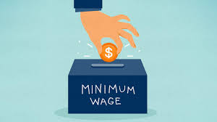
Minimum Wage
Jamel Ben Chafra

Slide 2
What is Minimum Wage?
The lowest remuneration that employers can legally pay their employees.
Became legal, in many countries, by the end of the 20th century.
Varies significantly from a country to a country and from a region to a region.
Notes:
Don’t forget to mention: Minimum wage is seen as a way to help lower-income families.

Slide 3
Minimum Wage in some European Countries (2025)
Country | Minimum Wage (Euros)
Portugal | 1,015
Spain | 1,381
France | 1,802
Germany | 2,161
Greece | 968
Ireland | 2,282

Slide 4
When was minimum wage adopted in some countries?
New Zealand (1894)
Australia (1896)
United States (1938)
United Kingdom (1909)

Slide 5
Minimum Wage Consequences
Improve overall standard of living
Improve worker morale
Reduce reliance on anti-poverty programs

Slide 6
Minimum Wage Consequences
Improve overall standard of living
Improve worker morale
Reduce reliance on anti-poverty programs
Boost consumer spending

Slide 7
Money Talks!

